Slide 1
Slide09 Alibaba Cloud Instructions
Prof. Ryan Leong Hou U

Slide 2
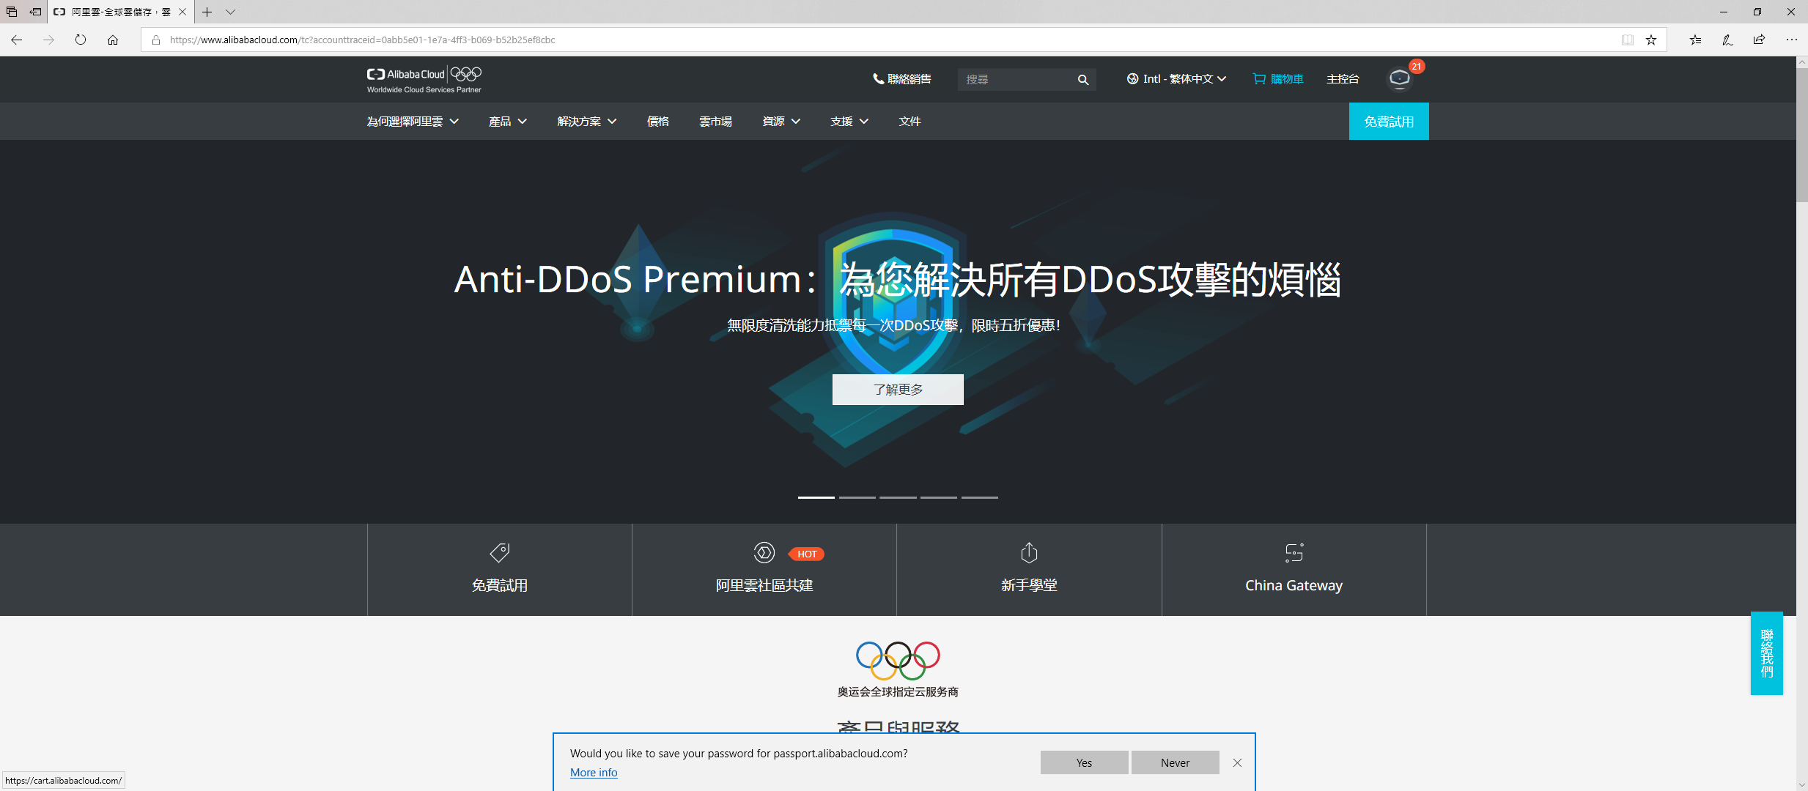
Go to Console

Slide 3
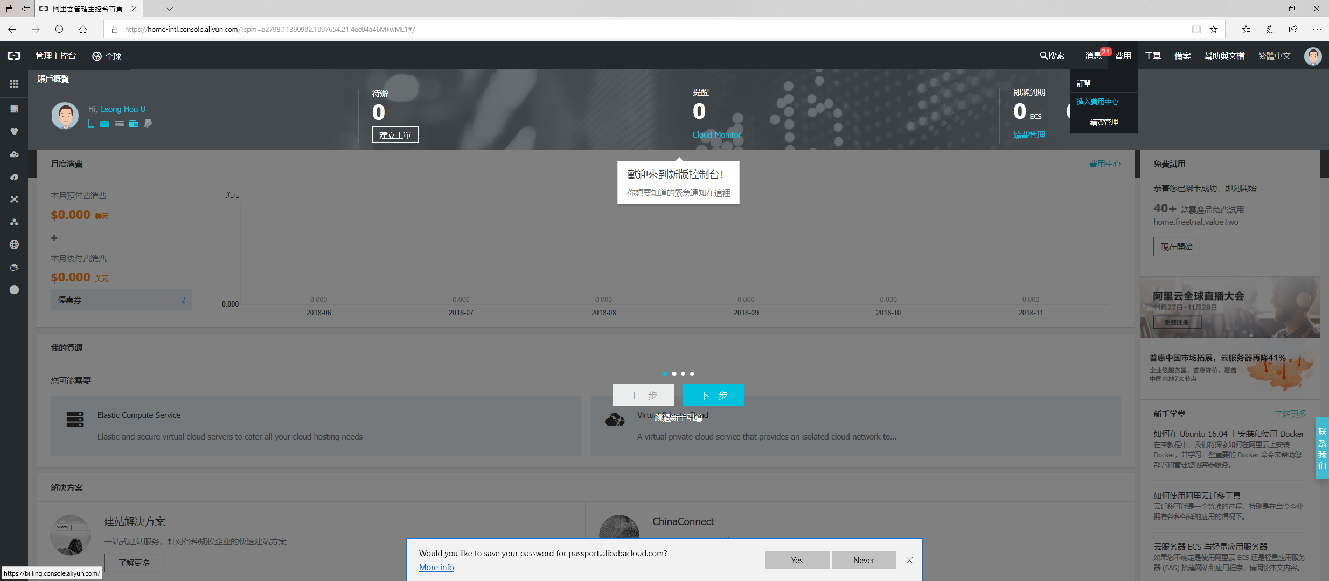
Check your coupons

Slide 4
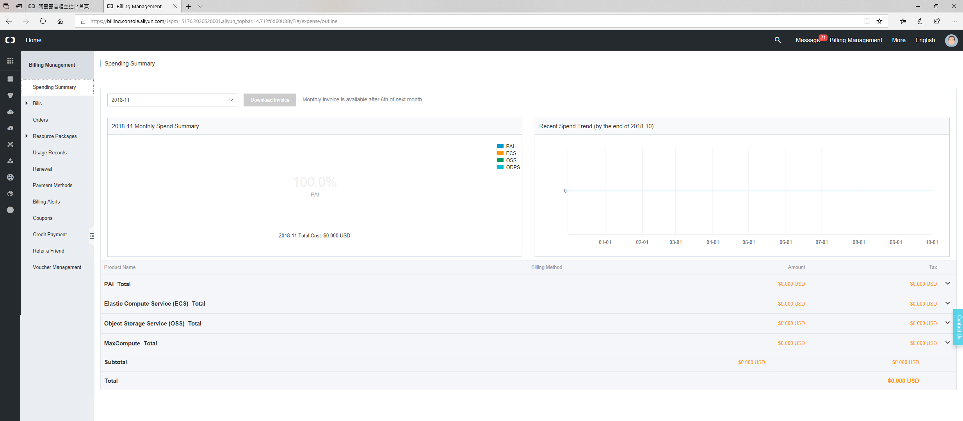
Check your coupons

Slide 5
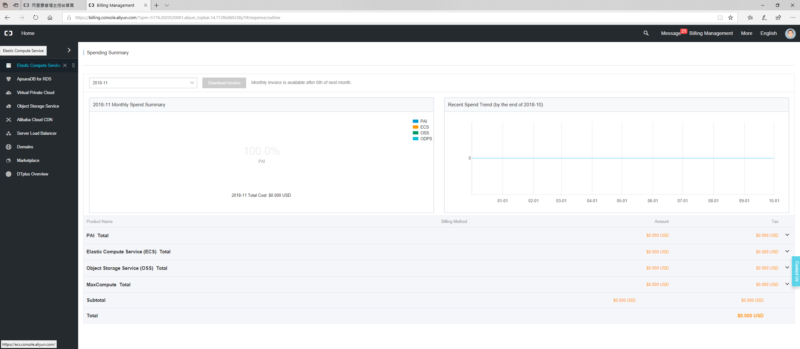
Elastic Compute Service

Slide 6
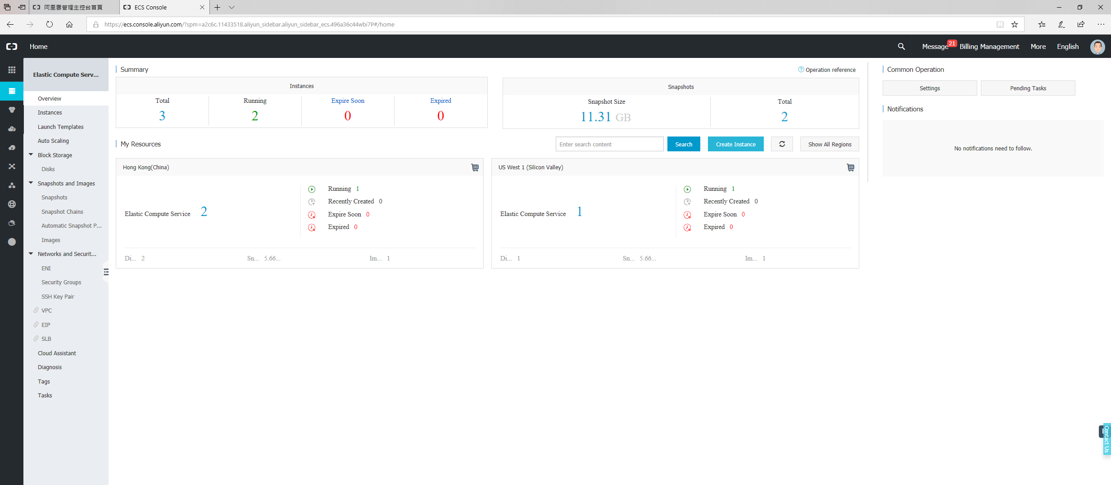
Create an Instance

Slide 7
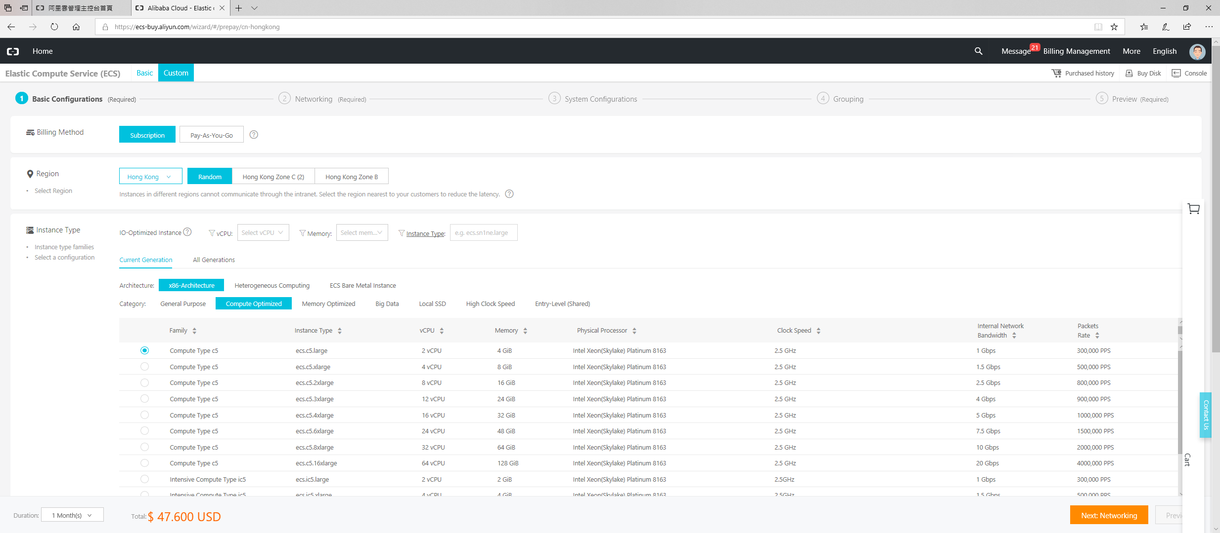
1. Instance configuration (suggested)
Pay-As-You-Go is cheaper
HK is a good choice

Slide 8
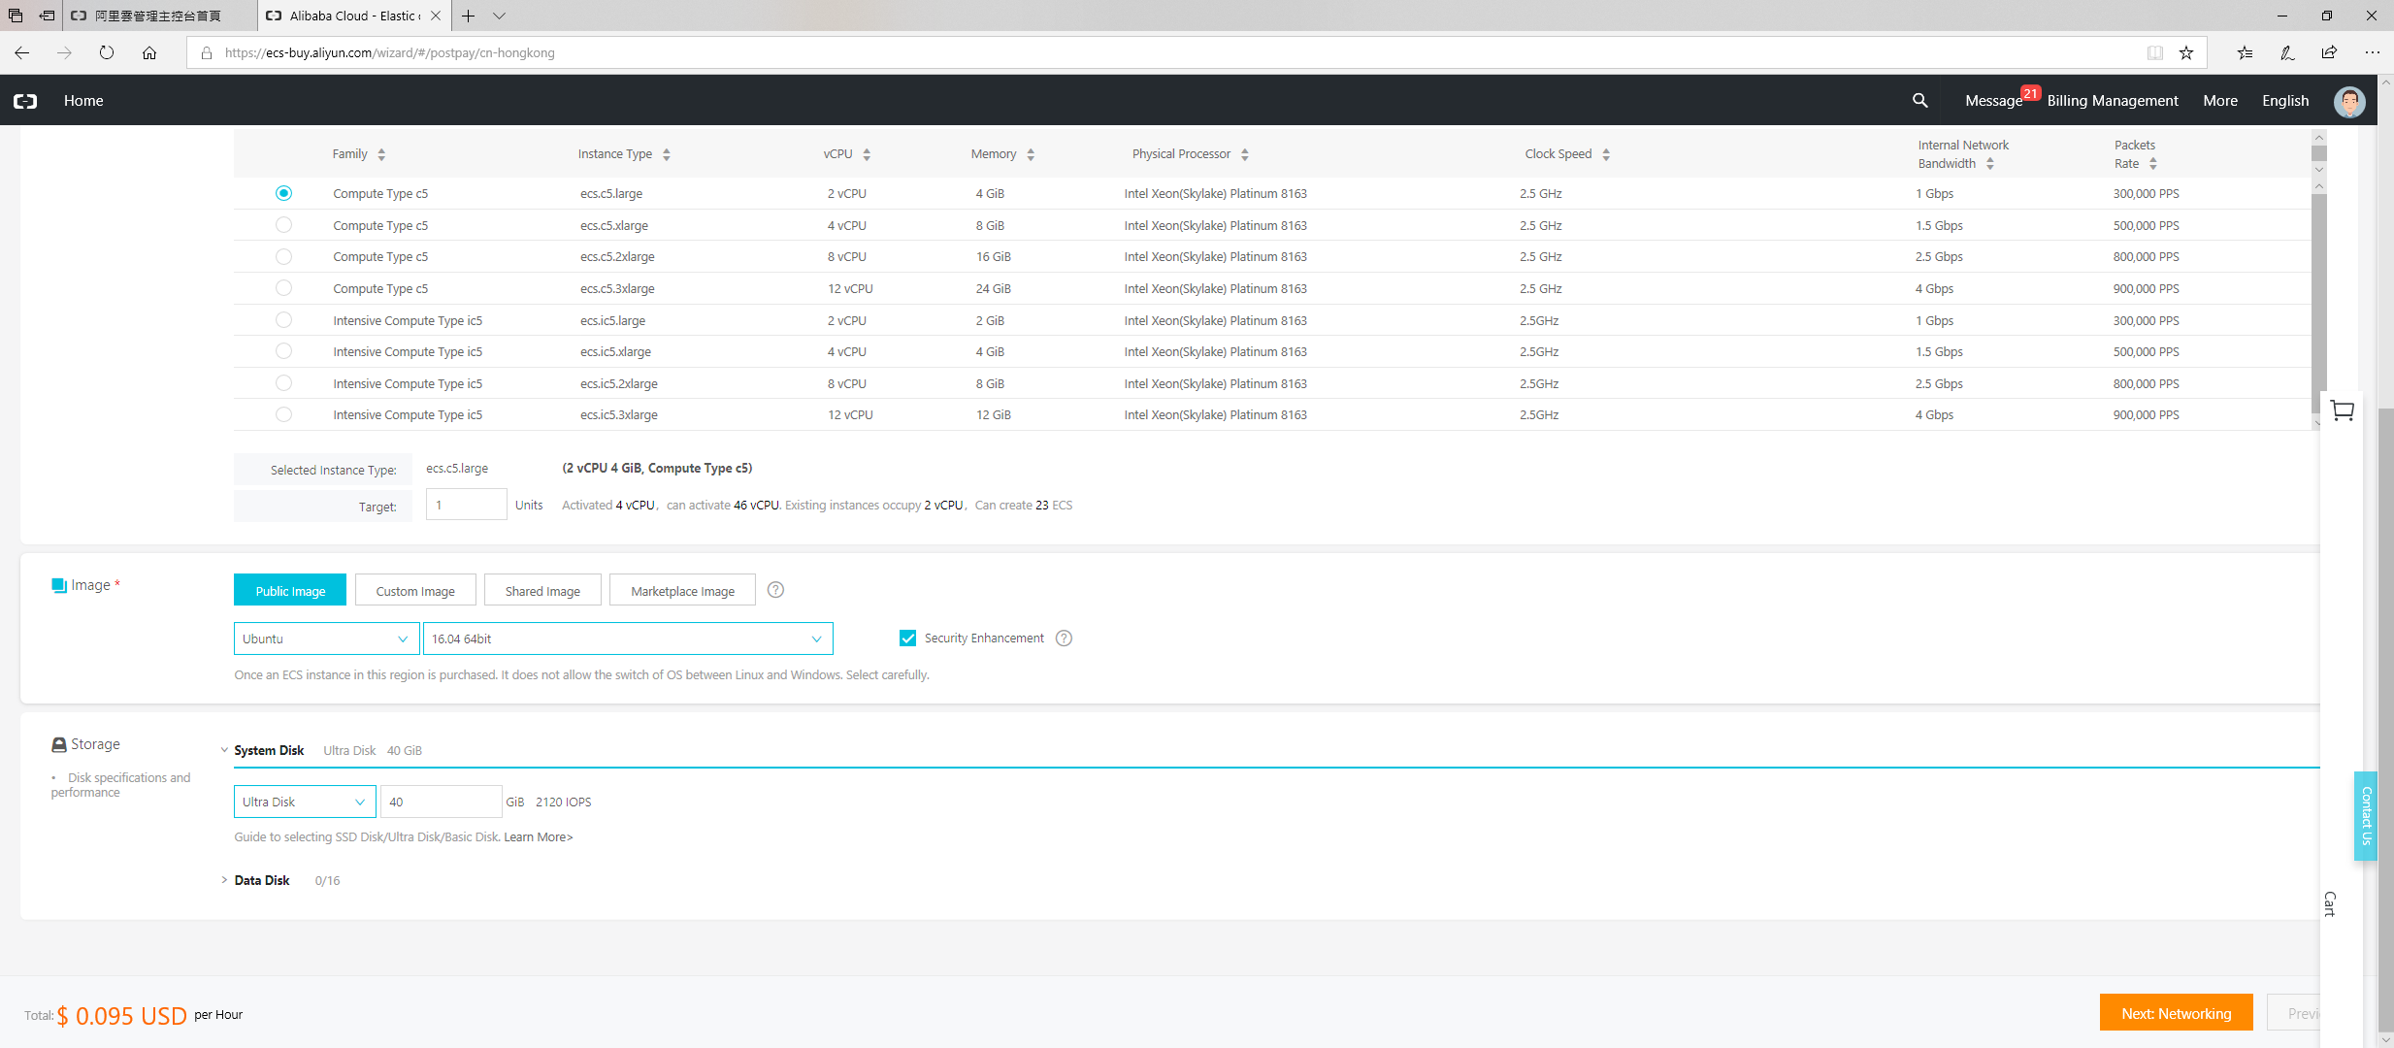
1. Instance configuration (suggested)
Ubuntu, 16.04

Slide 9
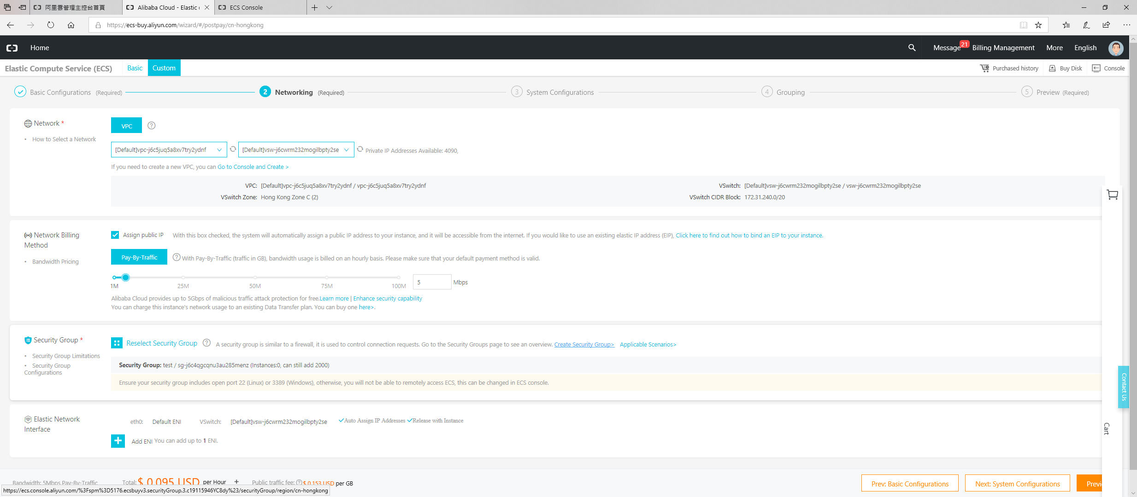
2. Network configuration
Click to configure it, this will open a new tab

Slide 10
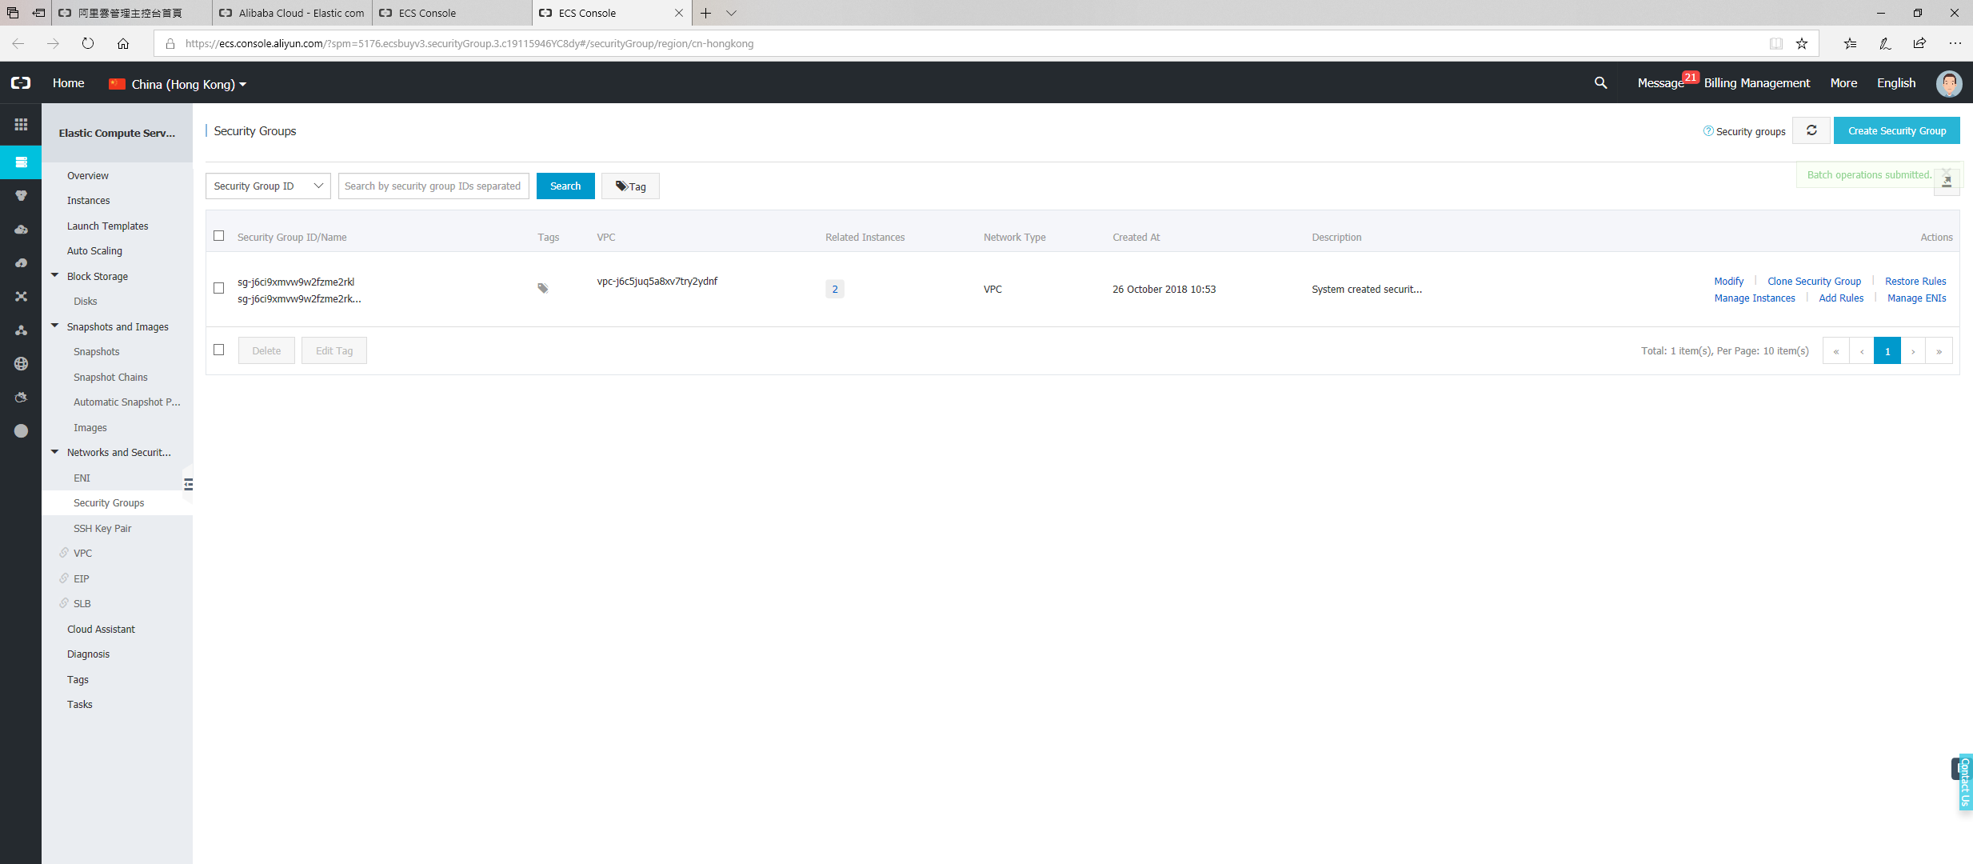
2.1 Setting up a security group
You are now at the page of Security Group

Slide 11
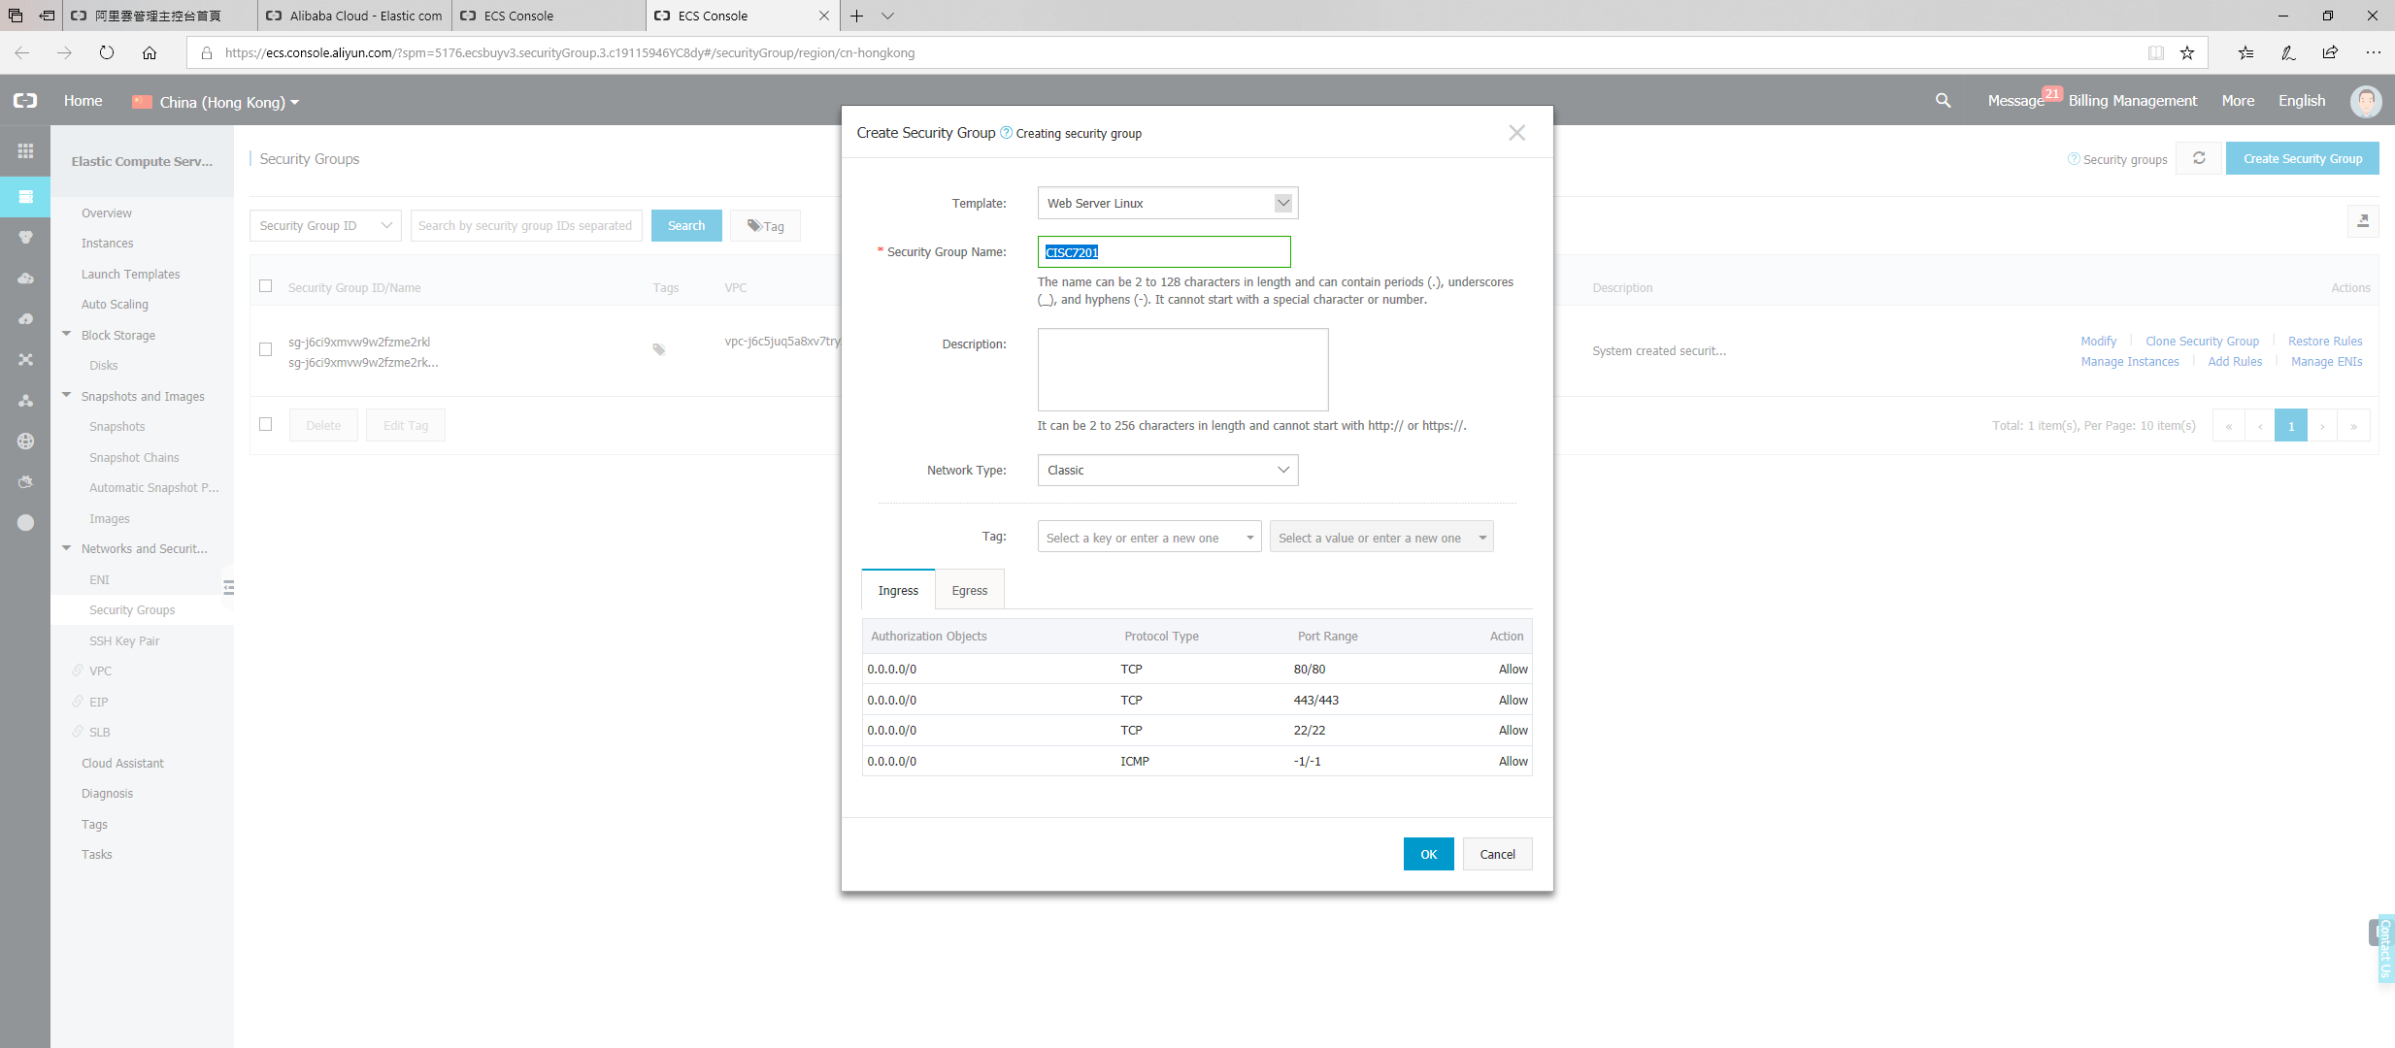
2.1 Setting up a security group

Slide 12
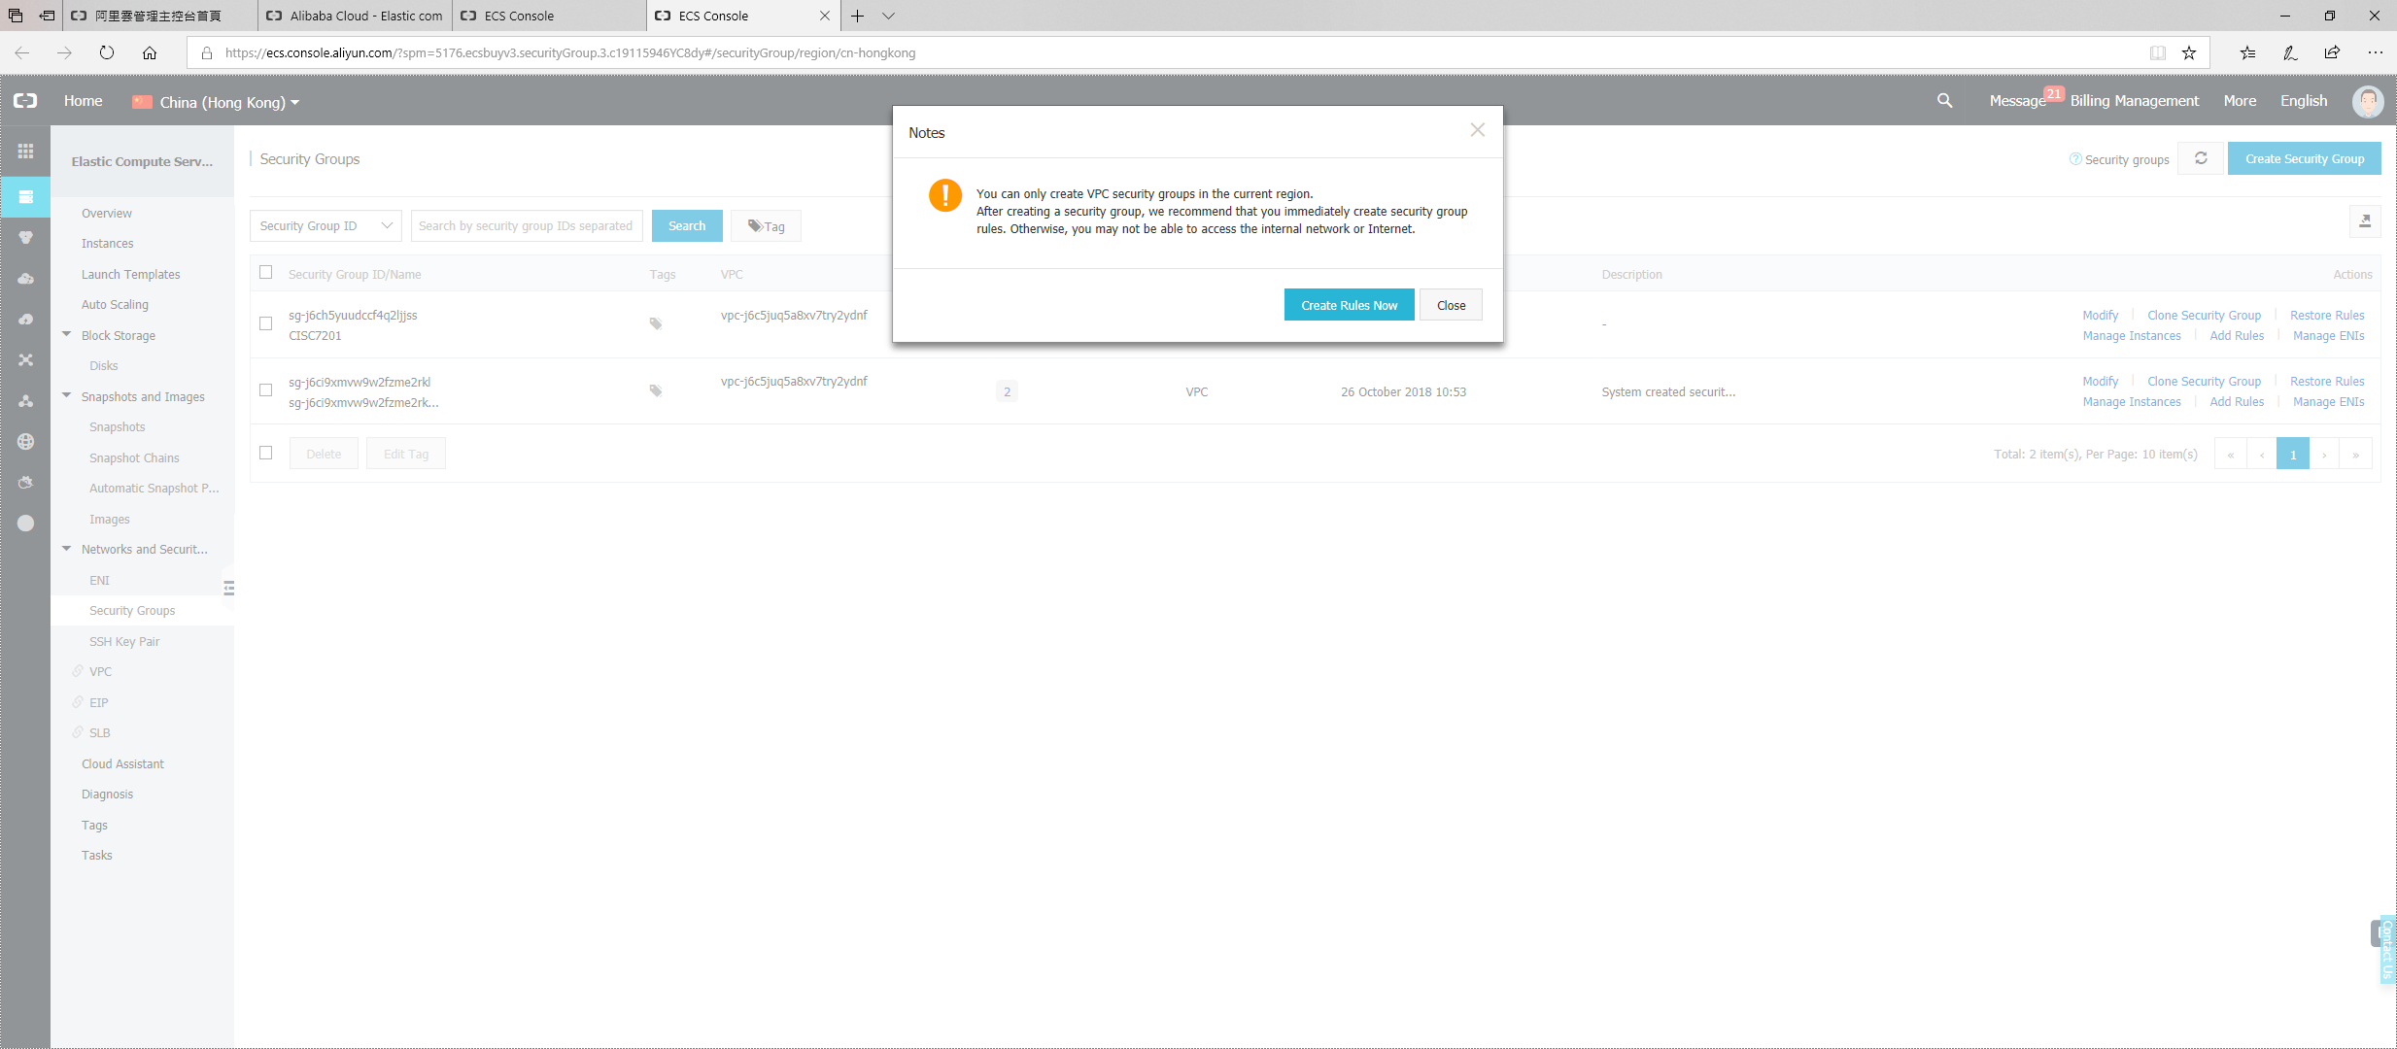
2.2 Configure a security group

Slide 13
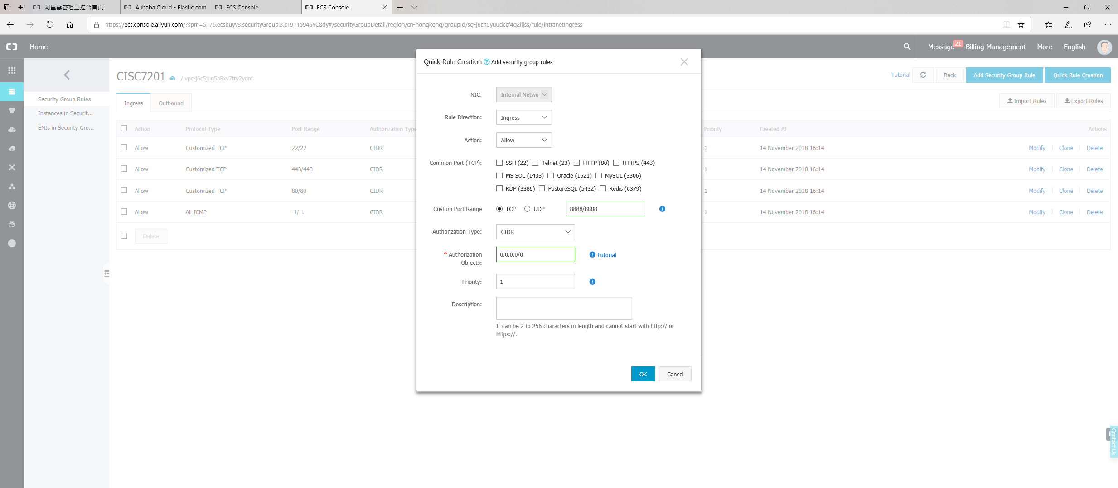
2.2 Adding a rule into the security group
First click on this button
This port (8888) is opened for Jupyter Notebook
Close this tab after you have added this rule into your security group

Slide 14
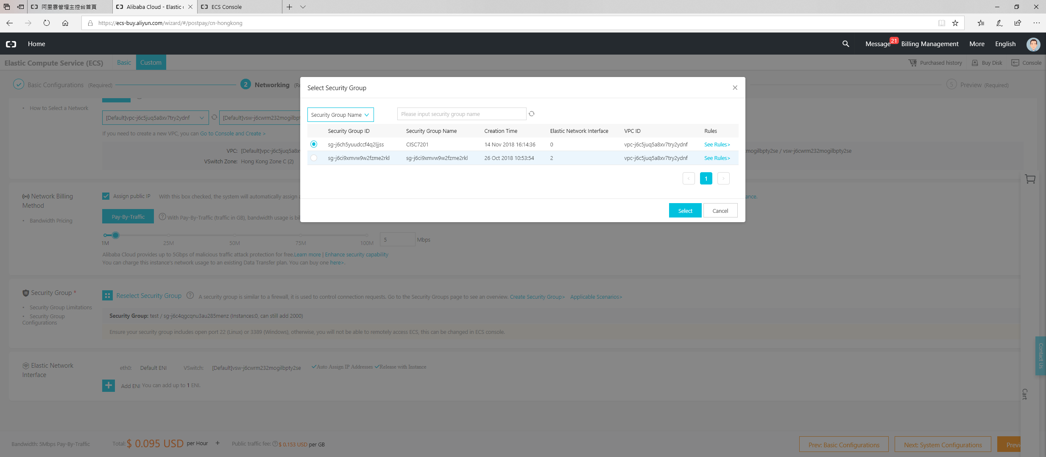
2. Network configuration
Select the one your just created
First click on this button
You are now back to the network configuration page

Slide 15
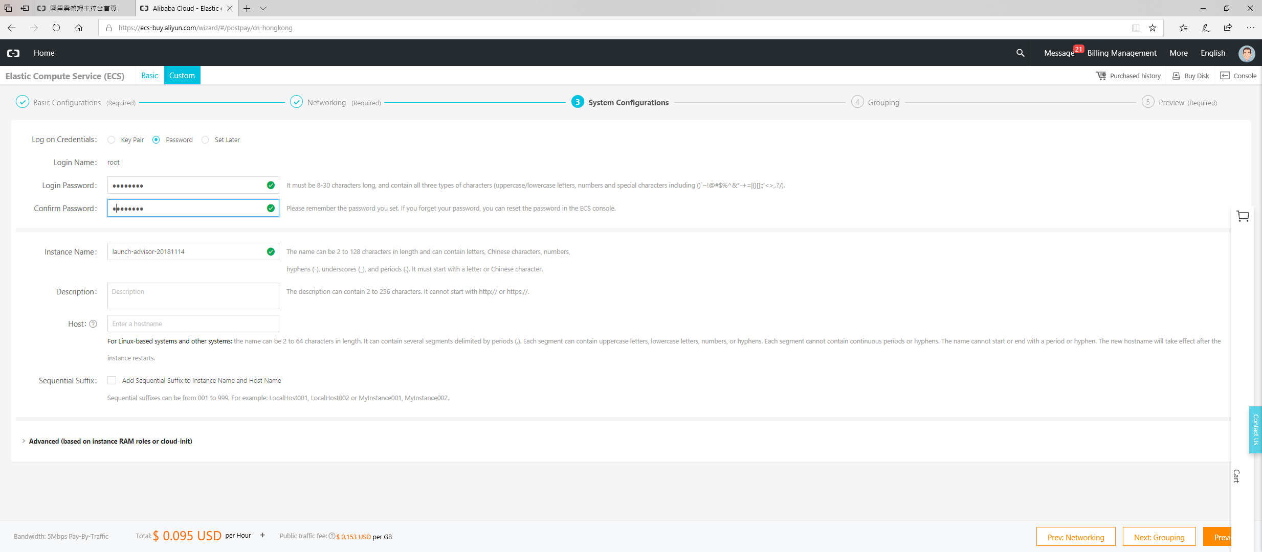
3. System configuration
Using password

Slide 16
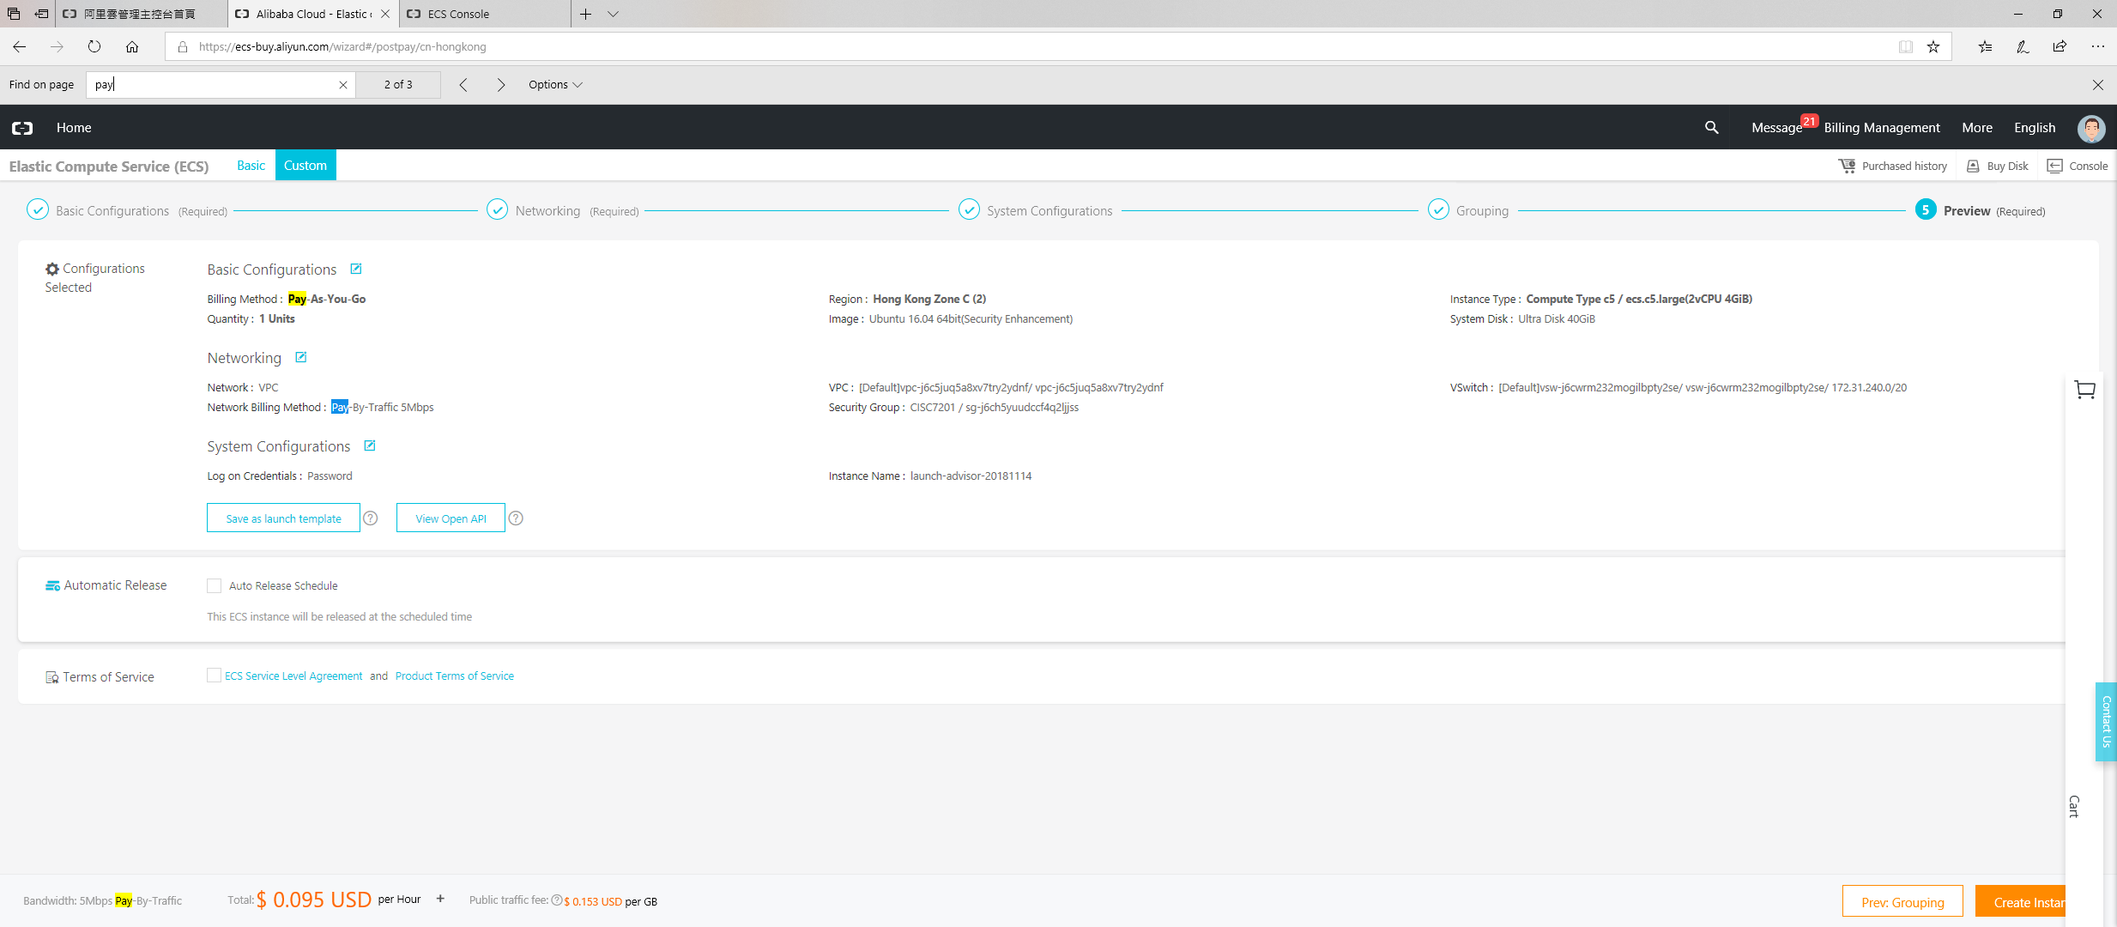
4. Confirm the instance

Slide 17
Accessing your ECS
Prof. Ryan Leong Hou U

Slide 18
SSH (Secure SHell)
Windows
Install Putty
https://putty.org/
MacOS or Linux
No installation is needed
Just type “ssh” in your command box

Slide 19
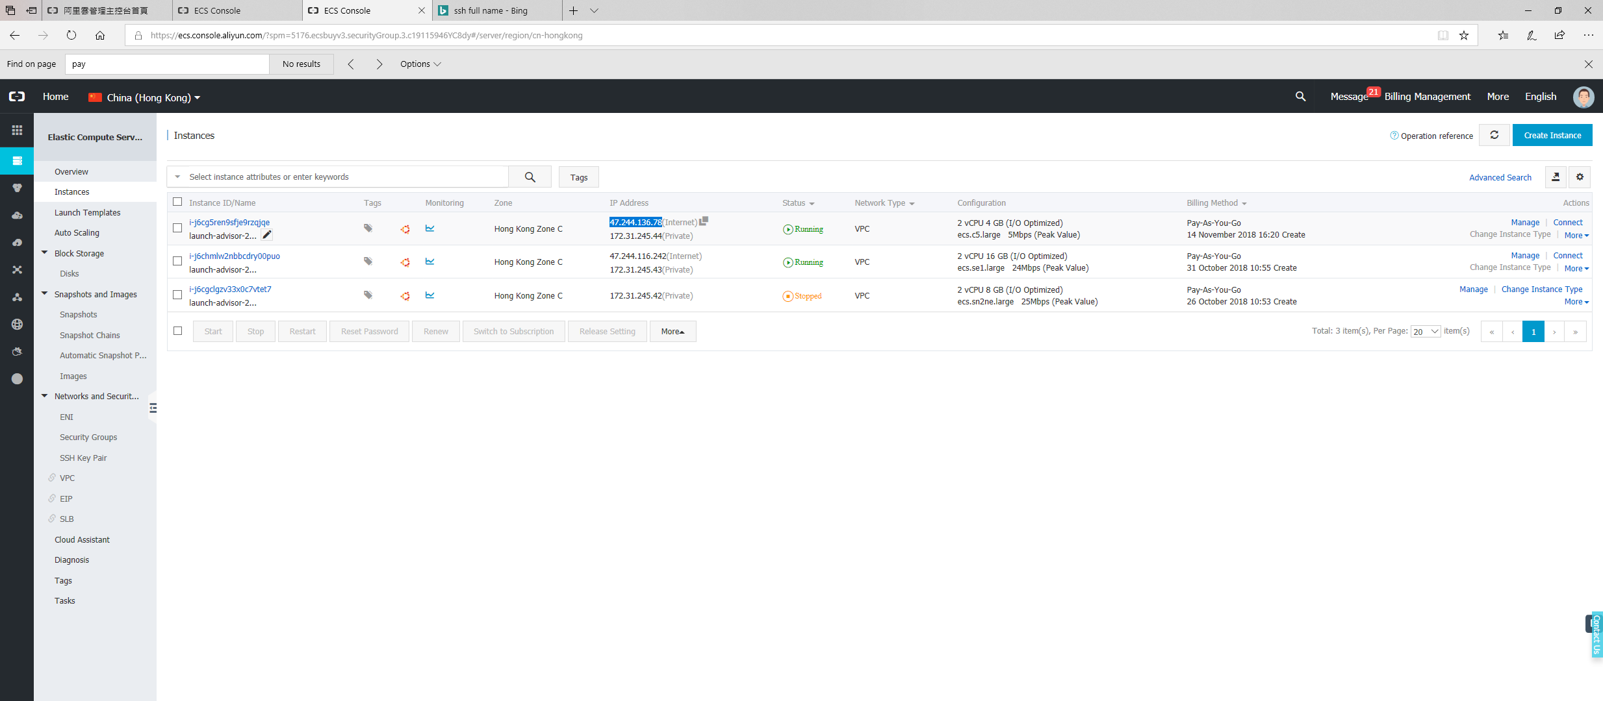
Find the IP address of your ECS
Find YOUR IP_ADDRESS (not mine)

Slide 20
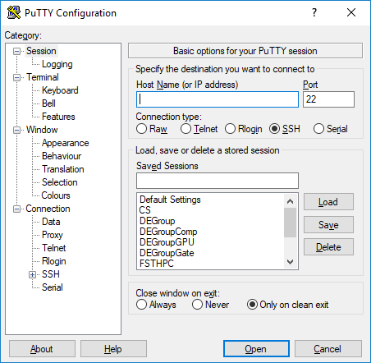
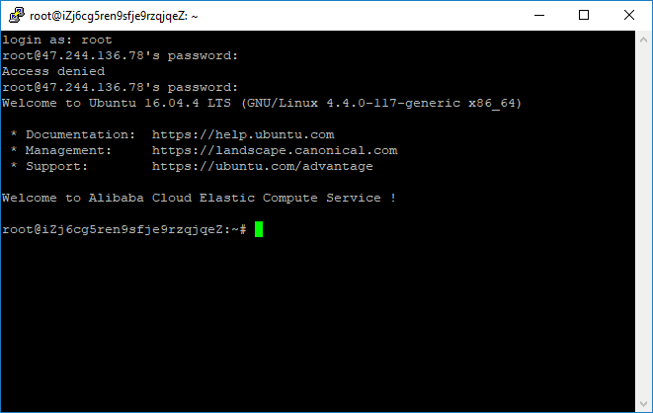
Remote access to your ECS
Input YOUR address (not mine)
Username: root
Password: Refer to Page 15
Windows
MacOS / Linux
ssh root@IP_ADDRESS
E.g., ssh root@47.244.136.78

Slide 21
Linux setup and package installation
Update the software list of your OS
~# apt-get update
Install PIP for Python3
~# apt-get install python3-pip
Install Jupyter Notebook for Python3
~# python3 –m pip install jupyter

Slide 22
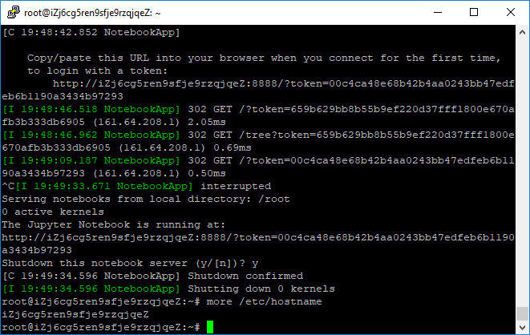
Using Jupyter Notebook @ ECS
Find the hostname of your ECS
Open Jupyter Notebook
~# jupyter notebook --ip= HOSTNAME --allow-root
~# jupyter notebook --ip=iZj6cg5ren9sfje9rzqjqeZ --allow-root
My ECS HOSTNAME is “iZj6cg5ren9sfje9rzqjqeZ”

Slide 23
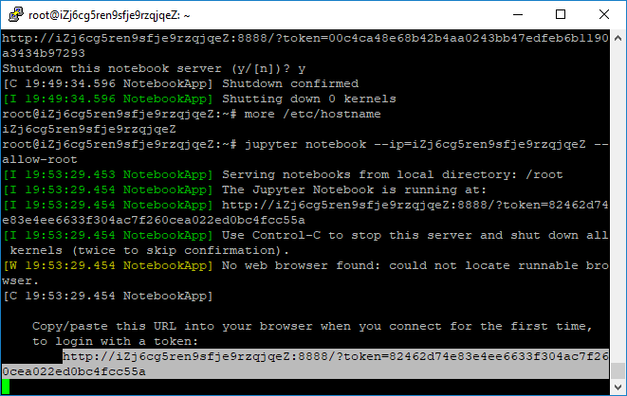
Using Jupyter Notebook @ ECS
Change the copied link from
http://iZj6cg5ren9sfje9rzqjqeZ:8888/?token=82462d74e83e4ee6633f304ac7f260cea022ed0bc4fcc55a
to
http://IP_ADDRESS:8888/?token=82462d74e83e4ee6633f304ac7f260cea022ed0bc4fcc55a
E.g., http:// 47.244.136.78:8888/?token=82462d74e83e4ee6633f304ac7f260cea022ed0bc4fcc55a
Open this link @ browser, then you will see the jupyter notebook
Copy this link

Slide 24
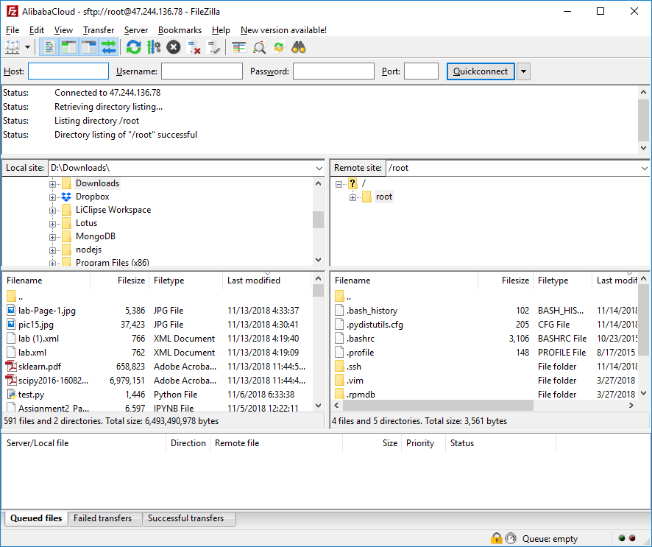
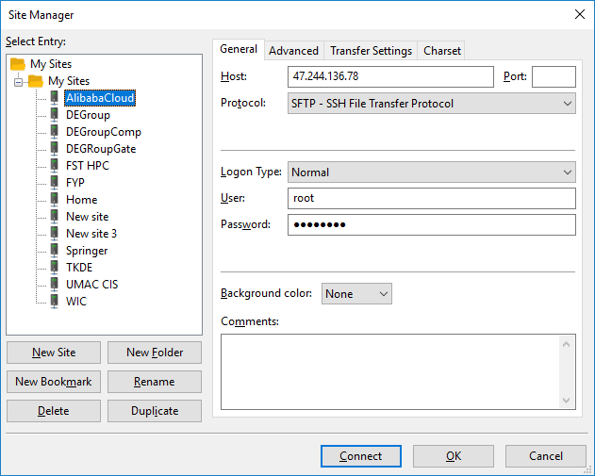
Upload / Download file to / from ECS
Filezilla
Available on Windows, MacOS, and Linux
1
IP_ADDRESS
Username and password
2

Slide 25

Upload / Download file to / from ECS
Your computer
ECS
Drag and drop

